Slide 1
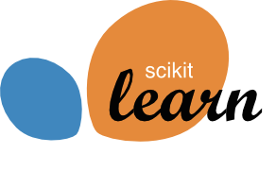
Lessons learned from scikit-learn (and how they helped me in research & life)
Vlad Niculae
Cornell University
https://vene.ro
Notes:
My name is Vlad, I’m a PhD student at Cornell, and something very strange has happened. Henry, Harshit and Reyv invited me here to talk not about boring research, but about opinions and experiences. I think that’s fantastic, and I hope you’re all ready for a very opinionated talk.

Slide 2
Who’s this guy?
Sterling is much cheaper than gold.
vs.
Her voice makes this song shine brighter than gold.
https://vene.ro/figurative-comparisons/

Slide 3

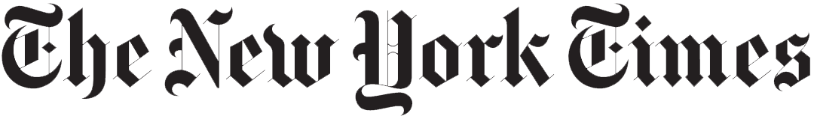
Who’s this guy?
America has been through big changes before—wars and depression, the influx of new immigrants, workers fighting for a fair deal […]
http://snap.stanford.edu/quotus/

Slide 4
Who’s this guy?
America has been through big changes before—wars and depression, the influx of new immigrants, workers fighting for a fair deal […]
http://snap.stanford.edu/quotus/

Slide 5

Who’s this guy?
Would it be ok with you if I took
Denmark? I think I'm going to need it
if I am going to hold France back.
https://vene.ro/betrayal

Slide 6
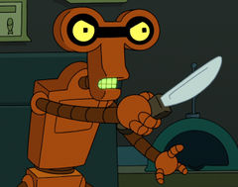
Who’s this guy?
Would it be ok with you if I took
Denmark? I think I'm going to need it
if I am going to hold France back.
https://vene.ro/betrayal
Notes:
Don’t explain this in detail. Takes too long.

Slide 7

Who’s this guy?
/r/ChangeMyView
https://chenhaot.com/pages/changemyview.html
CMV: Martin Shkreli is a victim of the uninformed and extremely biased media.
Notes:
But before all this, I was an undergrad, and I got involved with scikit-learn and the scientific python community.

Slide 8
Why contribute to open source?
Why is scikit-learn successful?
What are good practices for research code?

Slide 9
Why contribute to open source? Huge learning potential.
Why is scikit-learn successful?
What are good practices for research code?

Slide 10
Why contribute to open source? Huge learning potential.
Why is scikit-learn successful?
Good, consistent design and principles.
What are good practices for research code?

Slide 11
Why contribute to open source? Huge learning potential.
Why is scikit-learn successful?
Good, consistent design and principles.
What are good practices for research code?
Lessons from libraries transfer well.

Slide 12
Why contribute? (among many reasons)
Great feeling when people use your stuff. BSD!
Have code reviewed & review great code by others.
Not just coding tricks! Glimpse into what others use and why.
Start seeing your code through an API lens.
Join a community, blog, get retweets.

Slide 13
The secret sauce (user’s angle)
Notes:
Some things are obvious, like: keep your APIs consistent, fix bugs fast.

Slide 14
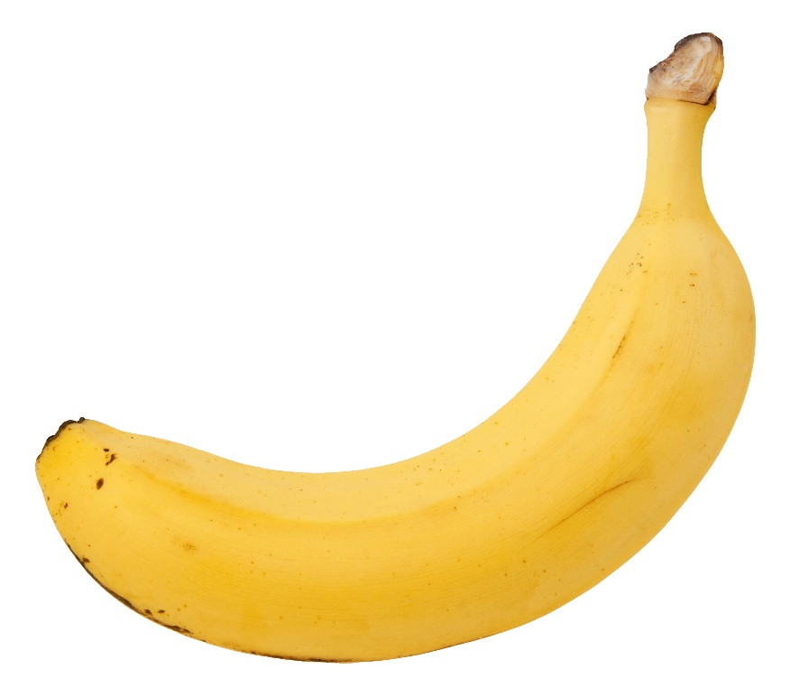
The secret sauce (user’s angle)
Not a framework: minimal glue, zero magic
Notes:
I can’t stress this enough. users wanting “a banana” should not get “a gorilla holding the banana and the entire jungle”

Slide 15
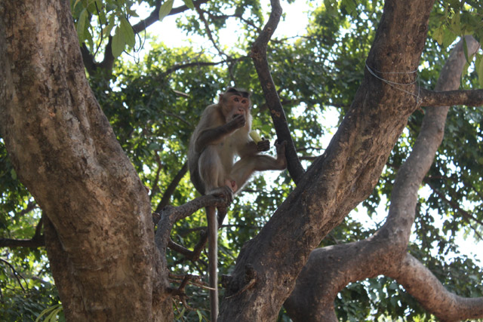
The secret sauce (user’s angle)
Not a framework: minimal glue, zero magic
Notes:
I can’t stress this enough. users wanting “a banana” should not get “a gorilla holding the banana and the entire jungle”

Slide 16
The secret sauce (user’s angle)
Not a framework: minimal glue, zero magic
Documentation, motivating examples.
Notes:
users wanting “a banana” should not get “a gorilla holding the banana and the entire jungle”

Slide 17
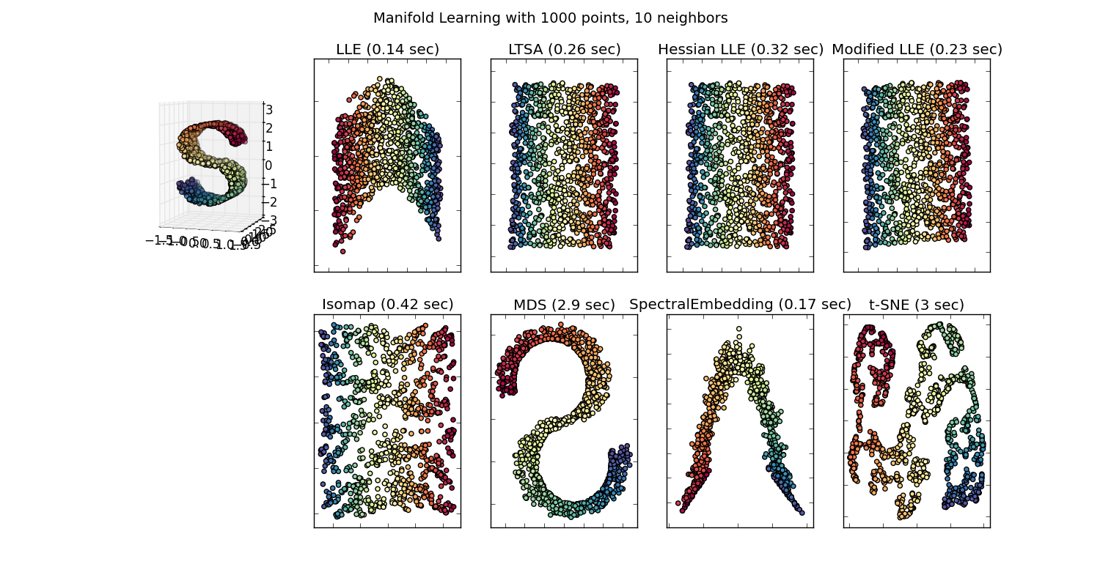
The secret sauce (user’s angle)
Not a framework: minimal glue, zero magic
Documentation, motivating examples.
Notes:
users wanting “a banana” should not get “a gorilla holding the banana and the entire jungle”

Slide 18
The secret sauce (user’s angle)
Not a framework: minimal glue, zero magic
Documentation, motivating examples.
Honest choice of what algorithms to include.
Notes:
users wanting “a banana” should not get “a gorilla holding the banana and the entire jungle”

Slide 19
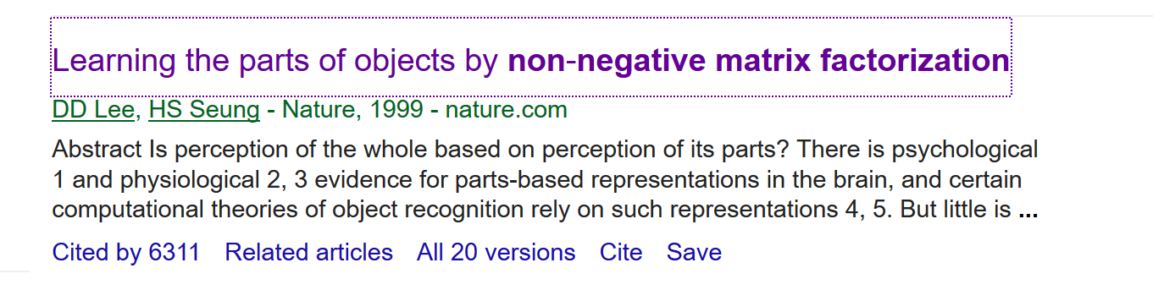
The secret sauce (user’s angle)
Not a framework: minimal glue, zero magic
Documentation, motivating examples.
Honest choice of what algorithms to include.
Notes:
users wanting “a banana” should not get “a gorilla holding the banana and the entire jungle”

Slide 20
The secret sauce (user’s angle)
Not a framework: minimal glue, zero magic
Documentation, motivating examples.
Honest choice of what algorithms to include.
Super Deep Sparse Extreme Machines [2016 FRESH MEGAHIT!!]
John Doe, arXiv preprint
-3
Notes:
At least I was just being young and naïve. But sometimes you see this:

Slide 21
The secret sauce (user’s angle)
Not a framework: minimal glue, zero magic
Documentation, motivating examples.
Honest choice of what algorithms to include.
Super Deep Sparse Extreme Machines [2016 FRESH MEGAHIT!!]
John Library-Author, arXiv preprint
-3
Notes:
I’m looking at you, WEKA!

Slide 22
The secret sauce (user’s angle)
Not a framework: minimal glue, zero magic
Documentation, motivating examples.
Honest choice of what algorithms to include.
Explore = develop = deploy
Notes:
users wanting “a banana” should not get “a gorilla holding the banana and the entire jungle”

Slide 23
The secret sauce (dev angle)
Not a framework: Easier to debug! Sometimes frustratingly limiting.
Documentation, motivating examples: (a) force devs to actually think more (b) good filter against bloat, useless contribs
Test coverage.

Slide 24
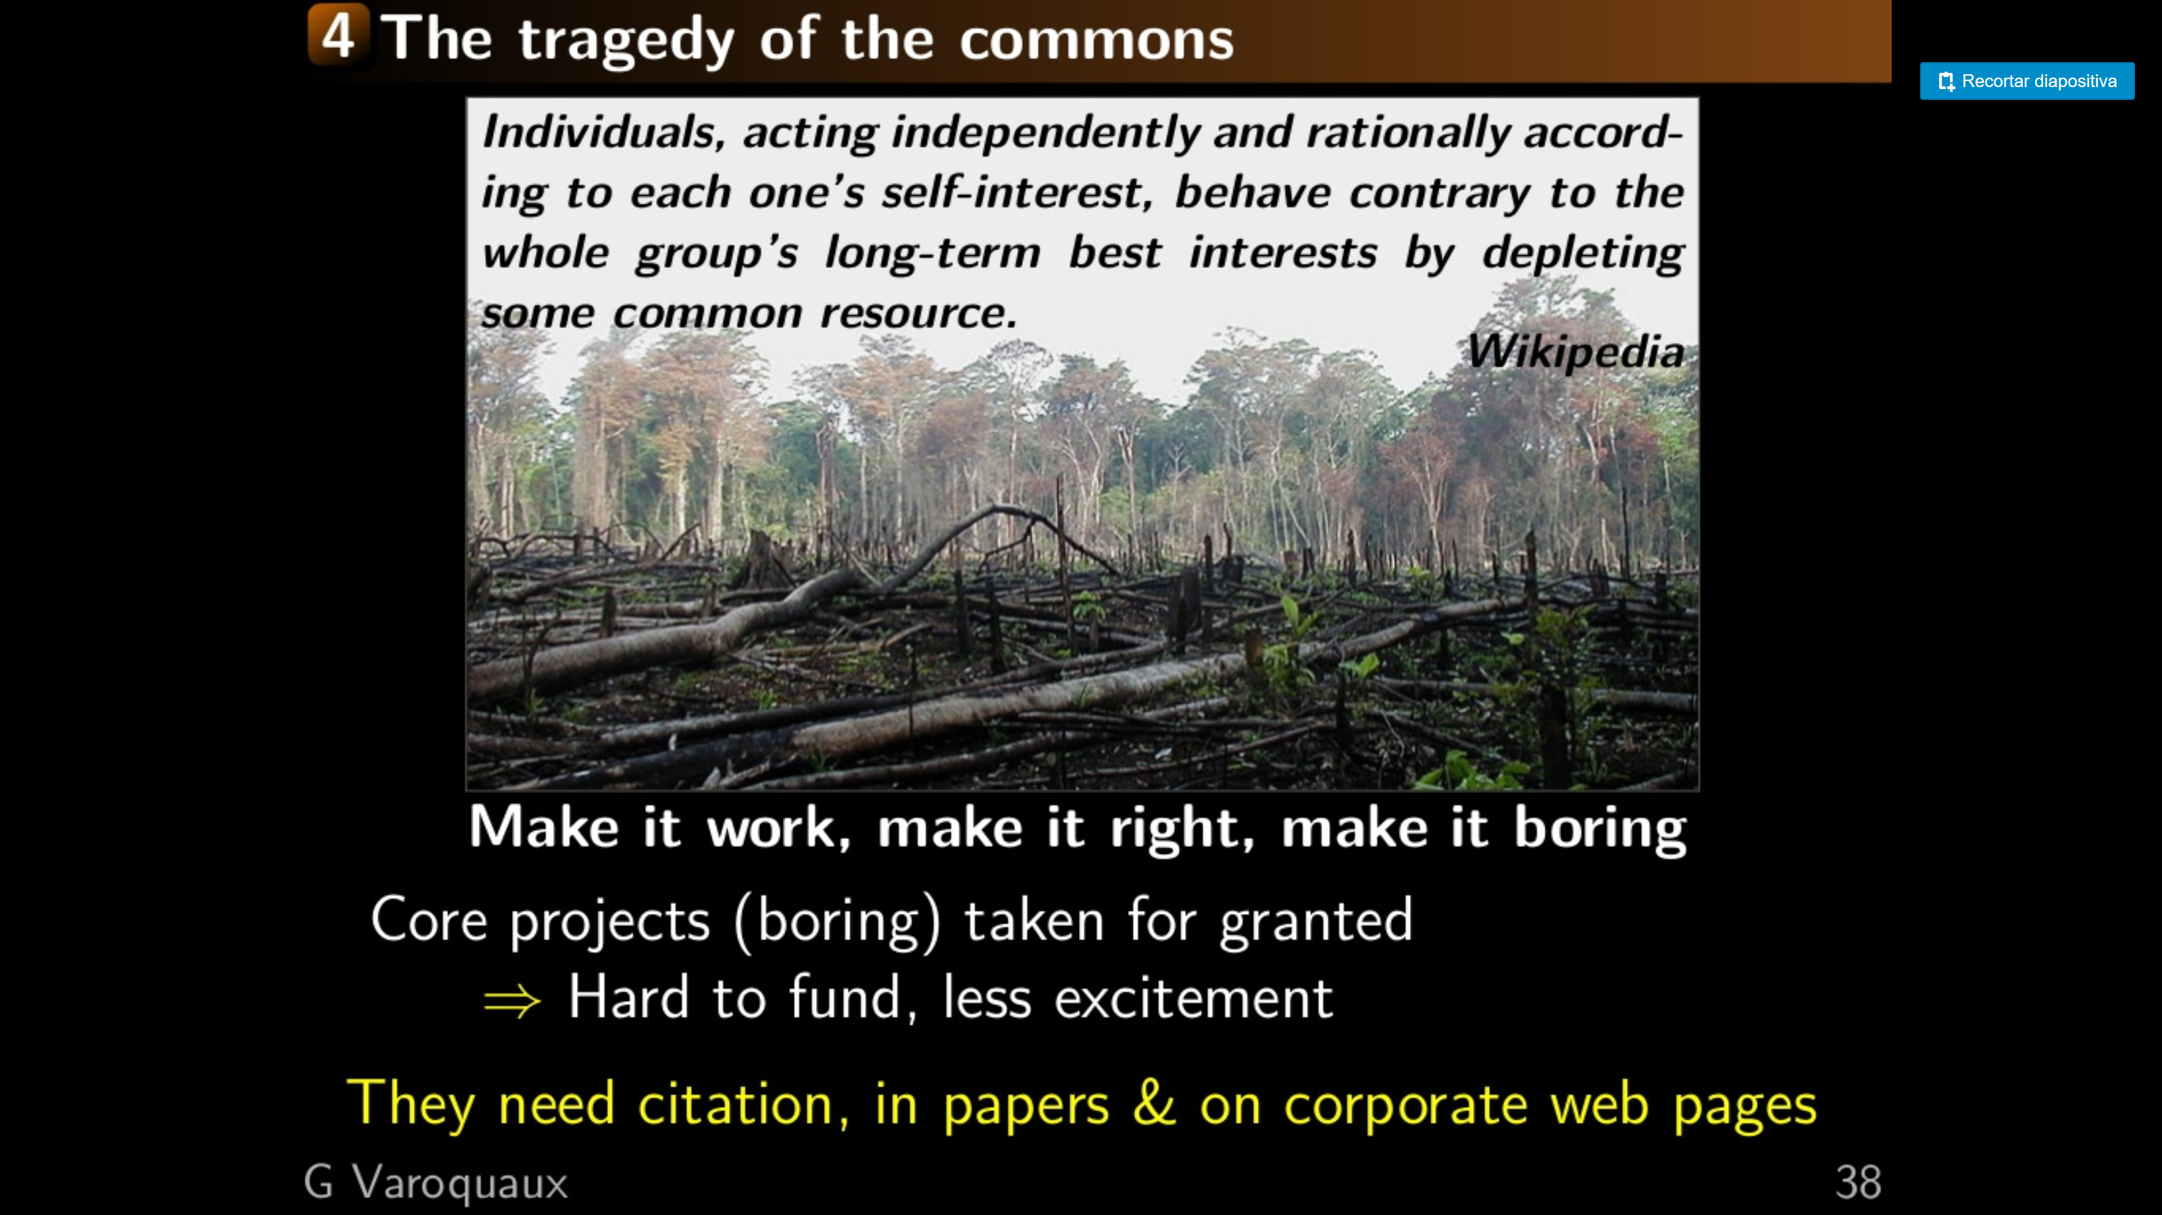
http://www.slideshare.net/GaelVaroquaux/simple-big-data-in-python

Slide 25
In your own work: but don’t look at mine :)
Your (research) code is a library, and your future self 3 weeks from now is a potential user. Make collaborators review your research code!
Code without unit tests is broken. Code with unit tests at least works sometimes. This is at odds with get it done…
Everything is useless until shown useful. Don’t get caught up on the latest greatest hyped method.

